Slide 1
Optimisation of Acute Logic’s Preferred Color algorithm

Slide 2
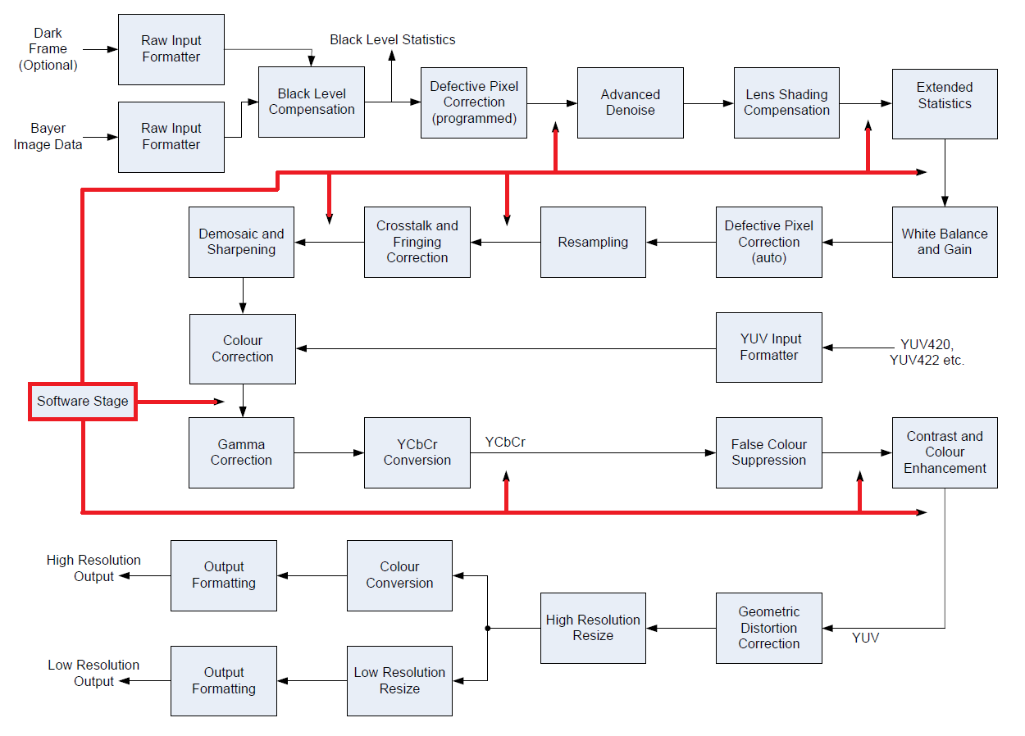
VIDEOCORE ISP PIPELINE
Most steps performed by hardware
Many are optional / configurable
Optional software intervention
Pre-processing (Bayer)
Internal SW stage (RGB)
Post-processing (YUV)
A SW stage can break into the pipeline at any of the places shown
Only one internal SW stage allowed
Current SW stage comprises “Saturation” and “Preferred Colors”
On full-resolution linear RGB data
Either side of Color Correction Matrix
Requires CCM in software too

Slide 3
Current algorithm and performance
Runs as an ISP software stage
On RGB data (13 bits per component, packed in memory as 48bpp)
After Saturation Control and Color Correction Matrix
Before Gamma Correction, YUV Conversion and Resize
Optimized for VideoCore® vector processor
Faithfully implements Acute Logic’s algorithm
Rearranged to avoid per-pixel branches and cases
Pixels are read and written in blocks, to optimize SDRAM usage
Using 16-way parallel MAC, can do a 3x3 matrix operation in 1 cycle/pixel
All matrices and color-bin tables are held in VPU local memories for speed
Integer division implemented using a fast method (accurate to about 8 sig bits)
Performance
Reference “C” code took about 300 cycles per pixel
Vector implementation takes about 8 cycles per pixel
That’s about 250ms per frame, for an 8 Megapixel camera

Slide 4
PERFORMANCE ANALYSIS AND LIMITATIONS
Step | Approx cycles / pixel | Time for 8Mpixels
Load and deinterleave RGB48 data | 1 | 32ms
Color Correction Matrix | 1 | 32ms
RGB→UV | 1 | 32ms
Find color angle | 1 | 32ms
Find color bin and look up matrix | 2 | 64ms
Apply per-pixel matrix | 1 | 32ms
Interleave and store RGB48 data | 1 | 32ms
Total | 8 | 256ms
Fundamental limits to performance
To load and store 8 Mpixels at 48bpp on 400MHz DDR SDRAM will take minimum 30ms
(best case, assuming 100% SDRAM availability, no display, no camera, no applications…)
Excludes computation, independent of which core or algorithm is used
Pipeline structure requires Color Correction Matrix to be performed in software
CCM adds another 32ms

Slide 5
Proposal
Change algorithm to run on YUV 4:2:0 images
Operate on U,V components only
Significantly reduces the volume of data to be read and written
Overcomes fundamental SDRAM bandwidth limitation
No need for the additional RGB→UV conversion step
Move the process later in the pipeline
Run on final 12bpp image before JPEG or H.264 compression
After Gamma Correction
After Resize
Algorithmic speedups
Reduce maximum number of possible color bins from 16 to 7
This allows “find angle” and “find color bin” steps to run faster
Acute Logic’s example configurations have used only 3 color bins
Expected performance
Expected to run in 3–4 cycles per U,V pair (equivalent to 0.75–1 cycle per pixel)
That’s about 32ms for 8 Megapixels, or about 9ms for 1920x1080 video

Slide 6
Issues
Preferred Colors now runs after Gamma Correction
Gamma Correction changes color differences
in general it “warps” color bin boundaries towards Magenta and away from Green
but the degree of warp depends on luminance and color-saturation, in non-linear ways
Effect of matrices is also changed
This will require new parameter settings
Will need to re-do tuning work
Acute Logic should be made aware that the algorithm now runs in the post-Gamma domain
Slight loss of resolution and accuracy
Now running on decimated 8-bit U,V components instead of 13-bit RGB
The algorithmic change implies a change to the parameter file/structure layout
This part of the change can be automated
a parameter file conversion tool will be provided
Assume that matrices do not modify Y component
Assume no more than 7 color bins

Slide 7
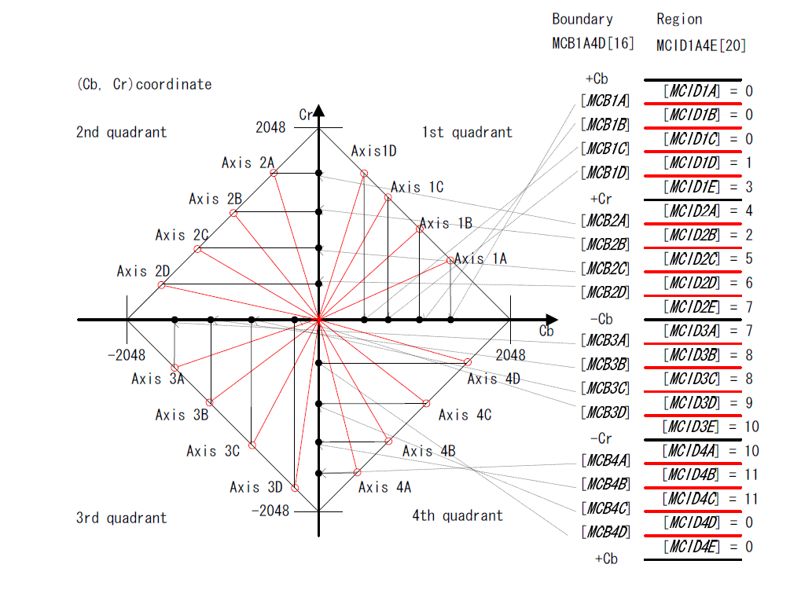
ORIGINAL ALGORITHM
Transform RGB→CbCr
In the linear-light domain
Choose quadrant
Fiddly edge cases (can be simplified)
Project color onto a diamond shape
Requires division operator (slow)
Project down onto one axis
Compare with 4 region boundaries
Boundaries depend on quadrant
Look up matrix number from region
Retrieve 3×3 matrix coefficients
Apply matrix in RGB domain
diagram © AcuteLogic. Confidential.

Slide 8

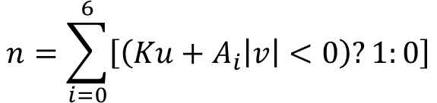
SIMPLIFIED ALGORITHM (INITIAL)
Operates directly on Gamma-corrected UV
JPEG or Rec.601, with the 128 offset removed
Test (u,|v|) against 7 “half-lines”
Each line specified by Ku+A_{i}|v|=0
Count how many lines fall to the right of (u,|v|)
Test whether v<0
Direct lookup of matrix coefficients
Apply 2×2 matrix in UV domain
V
5
4
3
6
2
(u,v)
1
7
K
0
-A₆
-A₅
-A₄
-A₃
-A₂
-A₁
-A₀
U
F
8
$$n=\sum_{i=0}^{6}{\left[\left(Ku+A_{i}\left|v\right|<0\right)?1:0\right]}$$
9
E
A
$$Lookup: \left(v<0,n\right)→Matrix$$
B
Parameters: { Matrix[16][2][2], A[7], K }
D
C

Slide 9

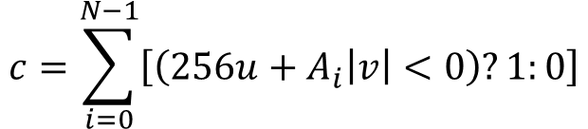
SIMPLIFIED ALGORITHM (REVISED)
Operates directly on Gamma-corrected UV
JPEG or Rec.601, with the 128 offset removed
Test (u,|v|) against up to 15 “half-lines”
Each line specified by 256u+A_{i}|v|=0
Count how many lines fall to the right of (u,|v|)
Test whether v<0
Direct lookup of matrix coefficients
Apply 2×2 matrix in UV domain
V
5
4
e.g. N=7
3
6
2
(u,v)
1
7
256
0
-A₆
-A₅
-A₄
-A₃
-A₂
-A₁
-A₀
U
F
8
$$c=\sum_{i=0}^{N−1}{\left[\left(256u+A_{i}\left|v\right|<0\right)?1:0\right]}$$
9
E
A
$$Lookup: \left(c,v<0\right)→Matrix$$
B
Parameters (all 16-bit): { Magic+N, A[15], Matrix[N+1][2][2][2] }
Magic=0xC010
D
C

